Slide 1

UNDERSTANDING MODERN DATA EXCHANGE
JSON and API Using Python
A Beginner Programming Guide

Slide 2
JSON, or JavaScript Object Notation, is a lightweight format used to store and exchange data. It organizes information in a simple, readable manner, similar to a digital filing cabinet filled with labeled folders. Each folder contains key-value pairs that make it easy to retrieve and manipulate data. JSON's simplicity and versatility have made it a popular choice for web services and APIs, facilitating seamless data interchange across various programming environments.
What is JSON?

Slide 3
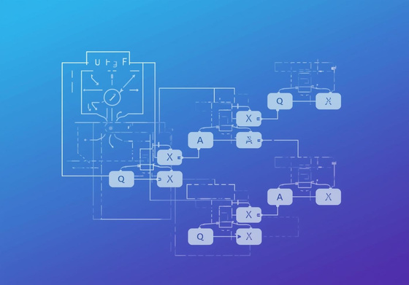
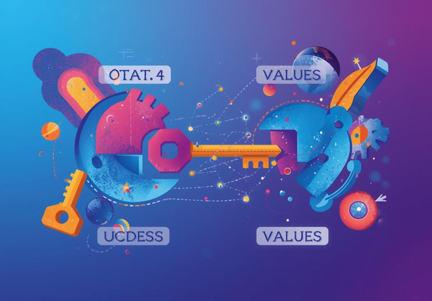
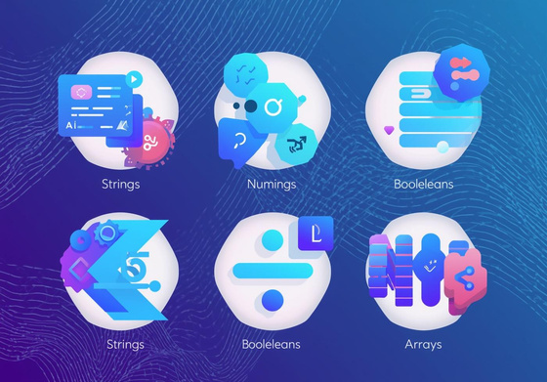
JSON Basics
Key-Value
Data Types
Nested Objects
Represents data in pairs for easy access.
Includes strings, numbers, booleans, and arrays.
Organizes complex data through layered structures.

Slide 4

JSON vs Python Dictionary: Key Syntax Differences
JSON keys must be strings with double quotes, while Python dictionaries can use different data types for keys.

Slide 5
The json module in Python simplifies data conversion between Python objects and JSON formatted strings. Using json.dumps(), you can convert a Python dictionary into a JSON string, making it ready for storage or transmission. Conversely, json.loads() allows you to parse a JSON string back into a Python object, enabling easy manipulation. This seamless integration of JSON in Python facilitates working with APIs and enhances data exchange in modern applications, making programming more efficient.
JSON in Python

Slide 6

Working with JSON Files

Slide 7
An API (Application Programming Interface) enables different applications to communicate seamlessly. It acts as a bridge, allowing one program to request data or services from another, much like a restaurant waiter takes orders and delivers food. By sending a request, the client interacts with a server that processes it and sends back the desired response. This interaction is vital for building modern applications that rely on data exchange and integration from various sources.
What is an API?

Slide 8
Making API Calls in Python with Requests
Learn how to efficiently fetch and send data using the requests library for seamless API communication.

Slide 9

JSON and API Connection

Slide 10
The Weather App Project allows beginners to learn how to fetch live weather data through APIs and parse JSON to display valuable information. By making an API request, the app retrieves data such as temperature, humidity, and conditions. Students will gain hands-on experience in handling JSON responses, extracting relevant details, and presenting them in a user-friendly format. This project emphasizes practical skills in programming while introducing key concepts of API interaction and data manipulation.
Weather App Project

Slide 11
The Currency Converter API enables developers to integrate real-time exchange rates into their applications. By making simple API calls, users can convert currencies effortlessly, making it invaluable for travel apps and finance tools. This API provides accurate data for various currency pairs, allowing for dynamic calculations. With just a few lines of code, programmers can enhance their applications, offering users up-to-date financial information at their fingertips.
Currency Converter API

Slide 12

Advantages & Conclusion
The importance of JSON and APIs in programming
EMAIL
hello@reallygreatsite.com
PHONE
123-456-7890
SOCIAL MEDIA
@reallygreatsite

